Slide 1

The New York Voter roll algorithms
www.zarkfiles.substack.com
Designed objects where they don’t belong

Slide 2
The purpose of voter rolls
Ensure all voters are eligible to vote (“qualified”)
Fraud prevention
Election management
To function, the rolls must be:
  Accurate
  Current
  Transparent (available for public scrutiny)

Slide 3
Voter roll laws (federal)
National Voter Registration Act (NVRA) of 1993 (52 U.S.C. §§ 20501-20511)
  Mandates that states maintain accurate and current voter registration rolls.
  Requires states to follow specific procedures for removing voters from the rolls.
Help America Vote Act (HAVA) of 2002 (52 U.S.C. §§ 20901-21145)
  Requires statewide computer voter lists
  Mandates unique identifier for each voter

Slide 4
Eligibility
Section 8(a)(3) of the NVRA (52 U.S.C. § 20507(a)(3)) requires:
  (I) specifies each eligibility requirement (including citizenship)
  (II) contains an attestation that the applicant meets each such requirement; and
  (III) requires the signature of the applicant, under penalty of perjury
In New York, there are about 2,000,000 records that can plausibly be described as in violation of these requirements
An unknown number, but nearly 100% of the sample so far, have forged signatures

Slide 5
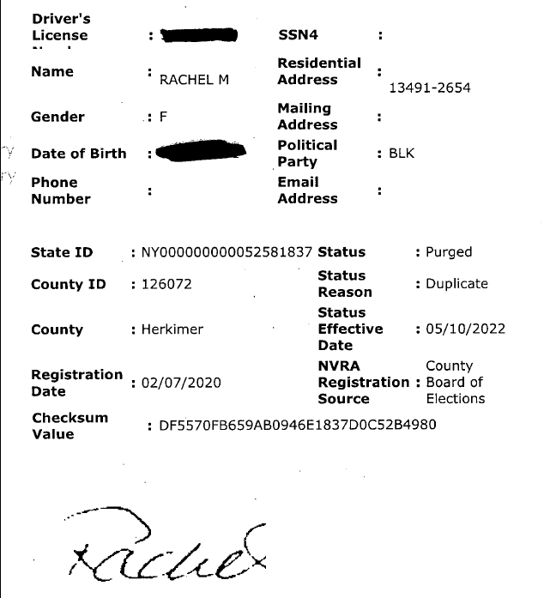
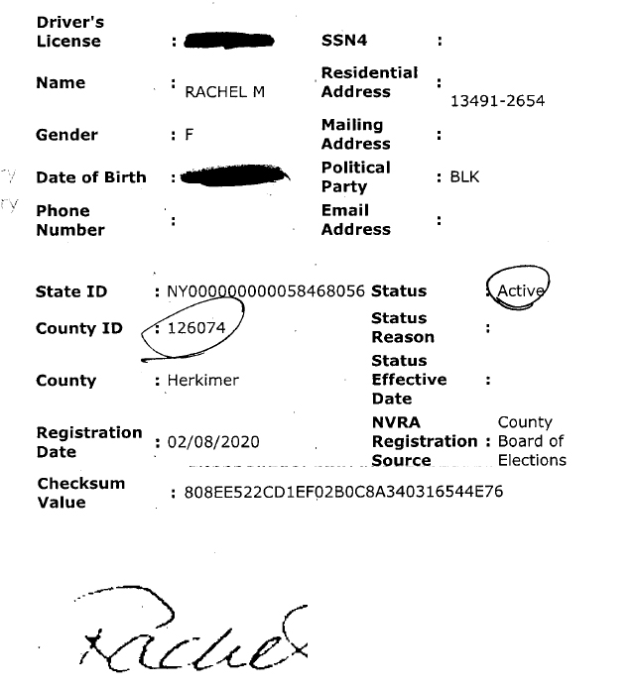
Example: Forged signature (mechanically duplicated)

Slide 6
Accuracy
New York’s rolls contain the following known errors:
  Incorrect name (spelling)
  Incorrect DOB
  Incorrect registration date
  Incorrect address
  Incorrect voter history
  Incorrect status
  Illegal records
All of these errors, and others not mentioned, would have been prevented if normal data validation tools were used
About 10% of all records are affected
  There may be more, undiscovered errors

Slide 7
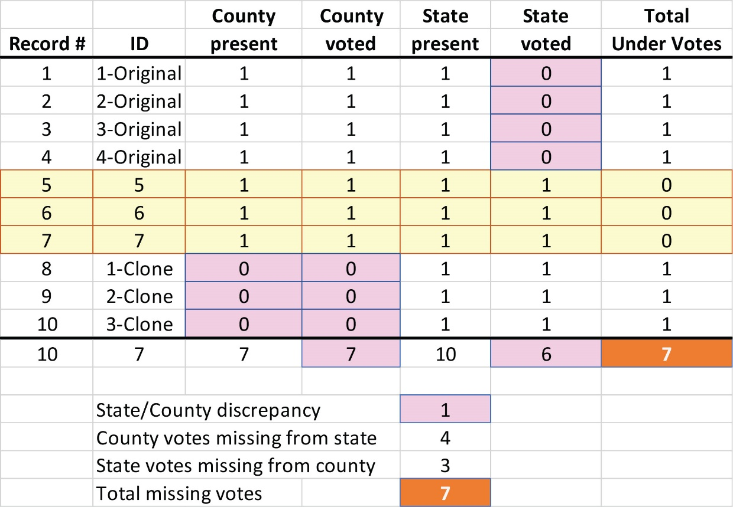
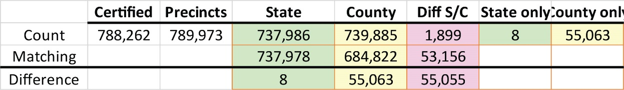
Discrepant voter histories
The Bus problem
Irreconcilable county to state rolls

Slide 8
Purged and cloned records
Over 8,000,000 purged records in the 2022 database
Almost 2,000,000 lack a purge date
  Meaning, they can be reactivated/deactivated at will without reference to a deactivation date
About 2,000,000 clones
500,000 deleted, destroying their audit trail
  But discovered thanks to an algorithm

Slide 9
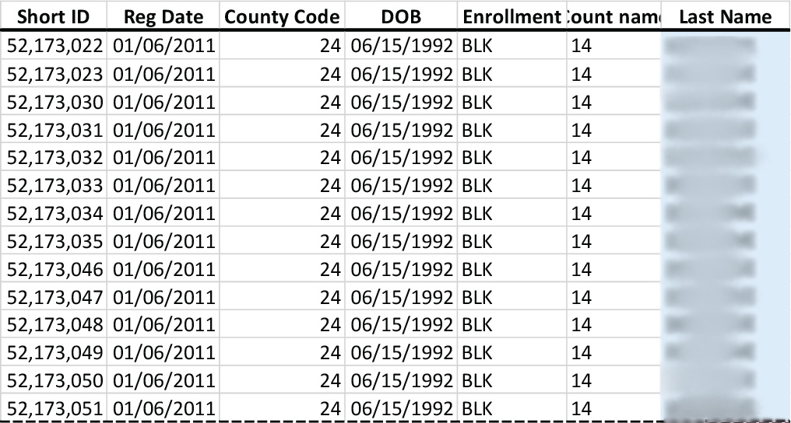
A clone example
14 SBOEID numbers assigned to the same person on the same day
Many are consecutive
If registrars followed the law, this would be impossible

Slide 10
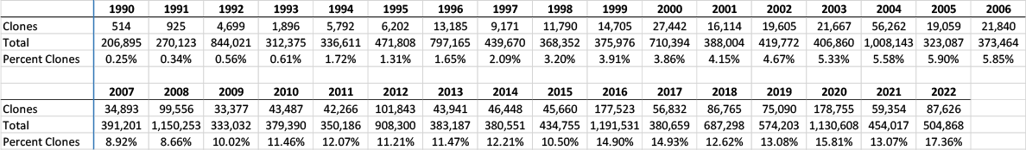
Clones by year
Prior to 1990, between 0-5 clones per year, with a few insignificant deviations
In 2020, the number of new clones was 178,755 out of 1,130,608 new registrations (15.81%)

Slide 11
Discovery of the algorithms
The presence of so many erroneous and/or illegal records raises the question:
If these problems were created intentionally, how would they be accessed?
To find individual or groups of cloned records in a database of 21 million records is not easy
Possible solutions:
  Tag the special records
    With a field for this attribute
    With special characters in an existing field
  Assign all records a trackable attribute
    If all records have it, discovery becomes difficult
    The attribute can connect to a separate database

Slide 12

Incentive
It would be very difficult to manipulate a significant volume of fraudulent records without a clandestine means to quickly identify them
Therefore, if the goal is to commit election fraud through the voter rolls, there is a strong incentive to create this method

Slide 13
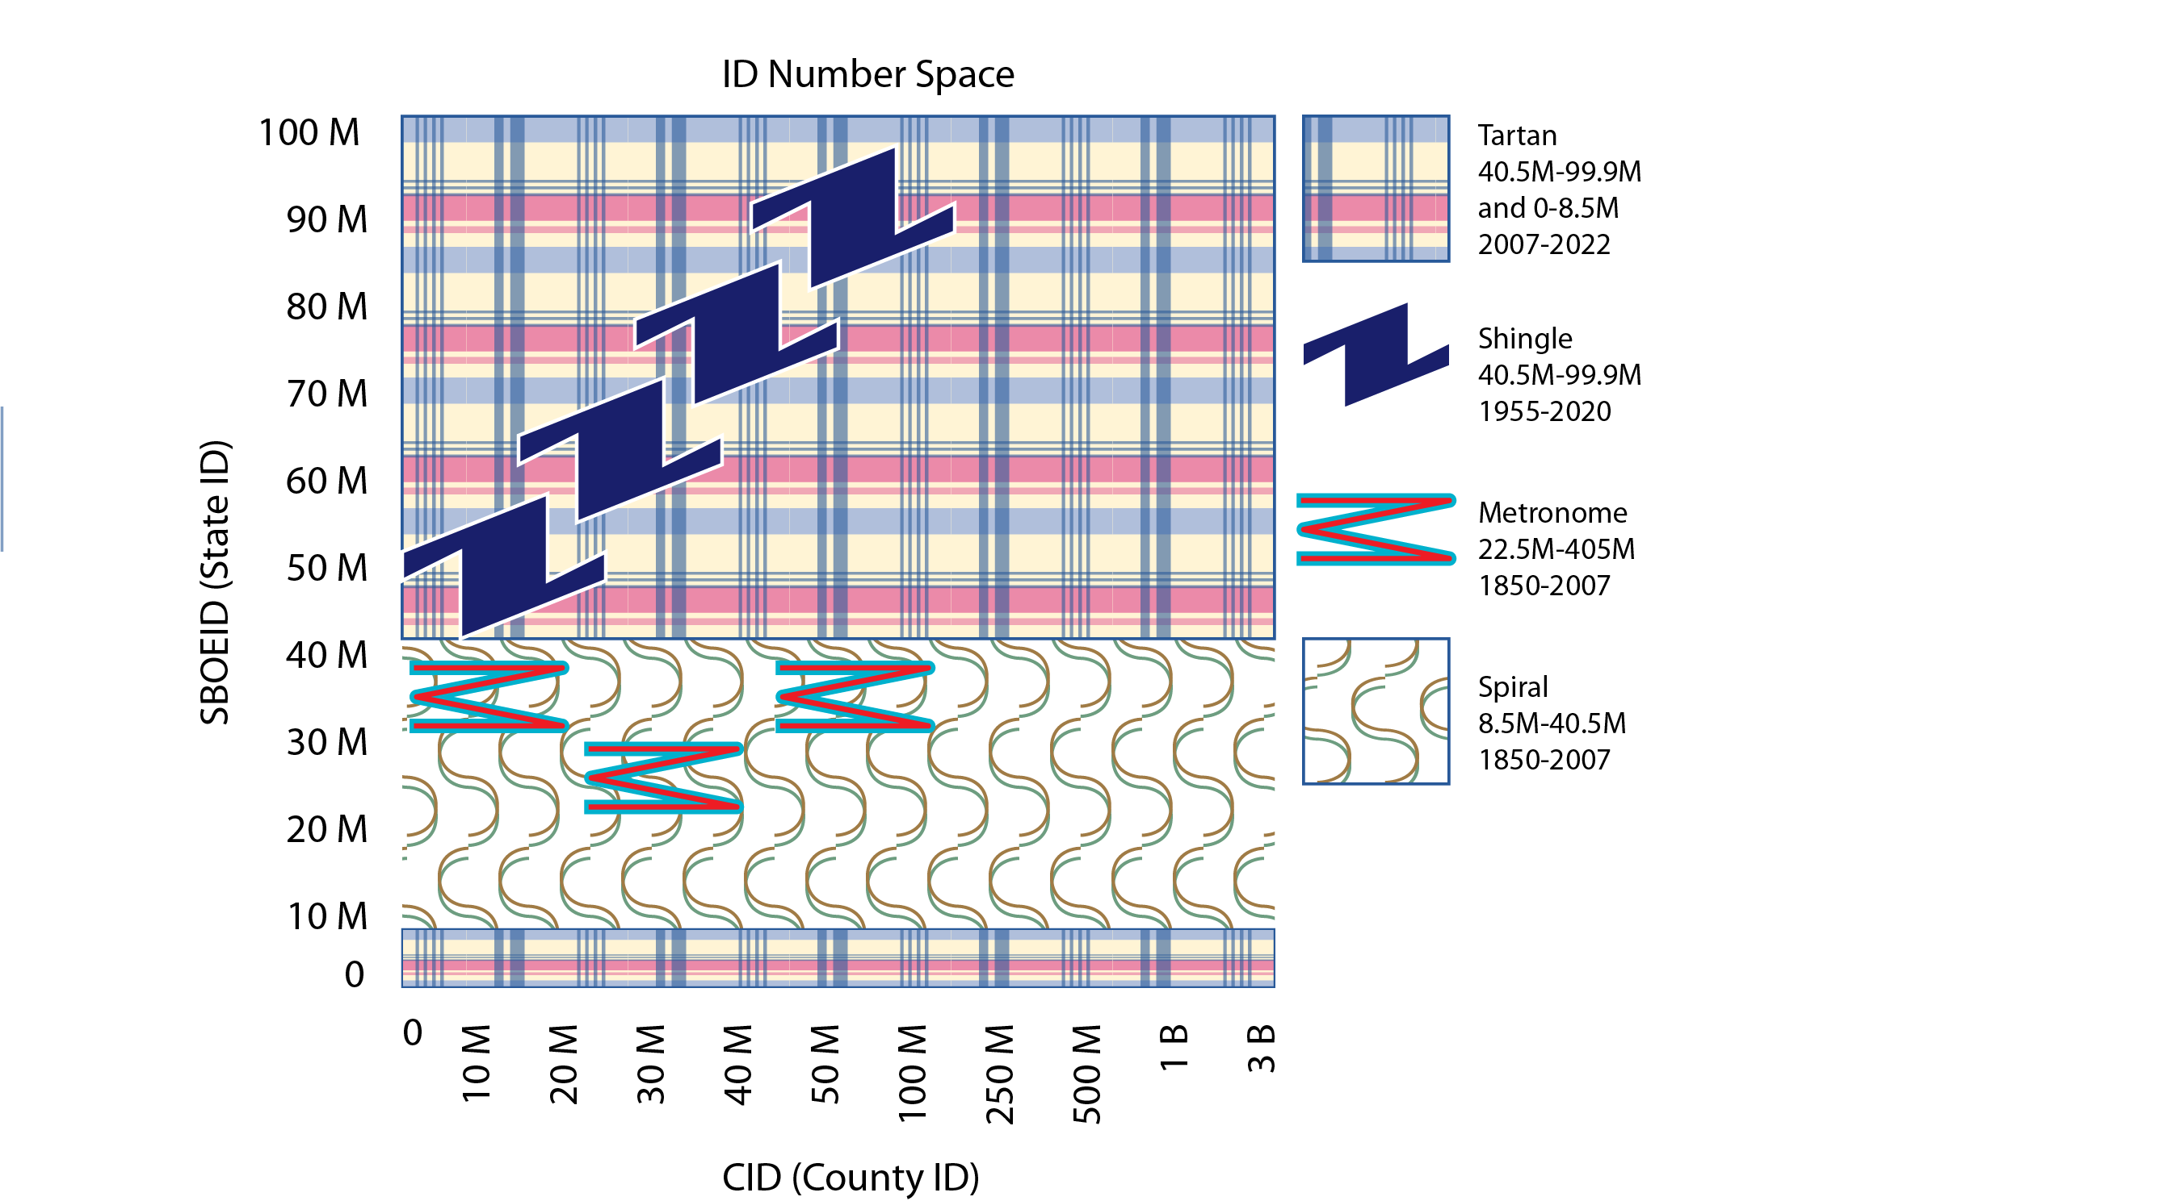
Algorithms
There are 4 algorithms in NY’s voter rolls
  Spiral
  Metronome
  Shingle
  Tartan
Their presence is disguised by 2 primary partitions (in-Range and Out of range) and numerous sub-partitions

Slide 14
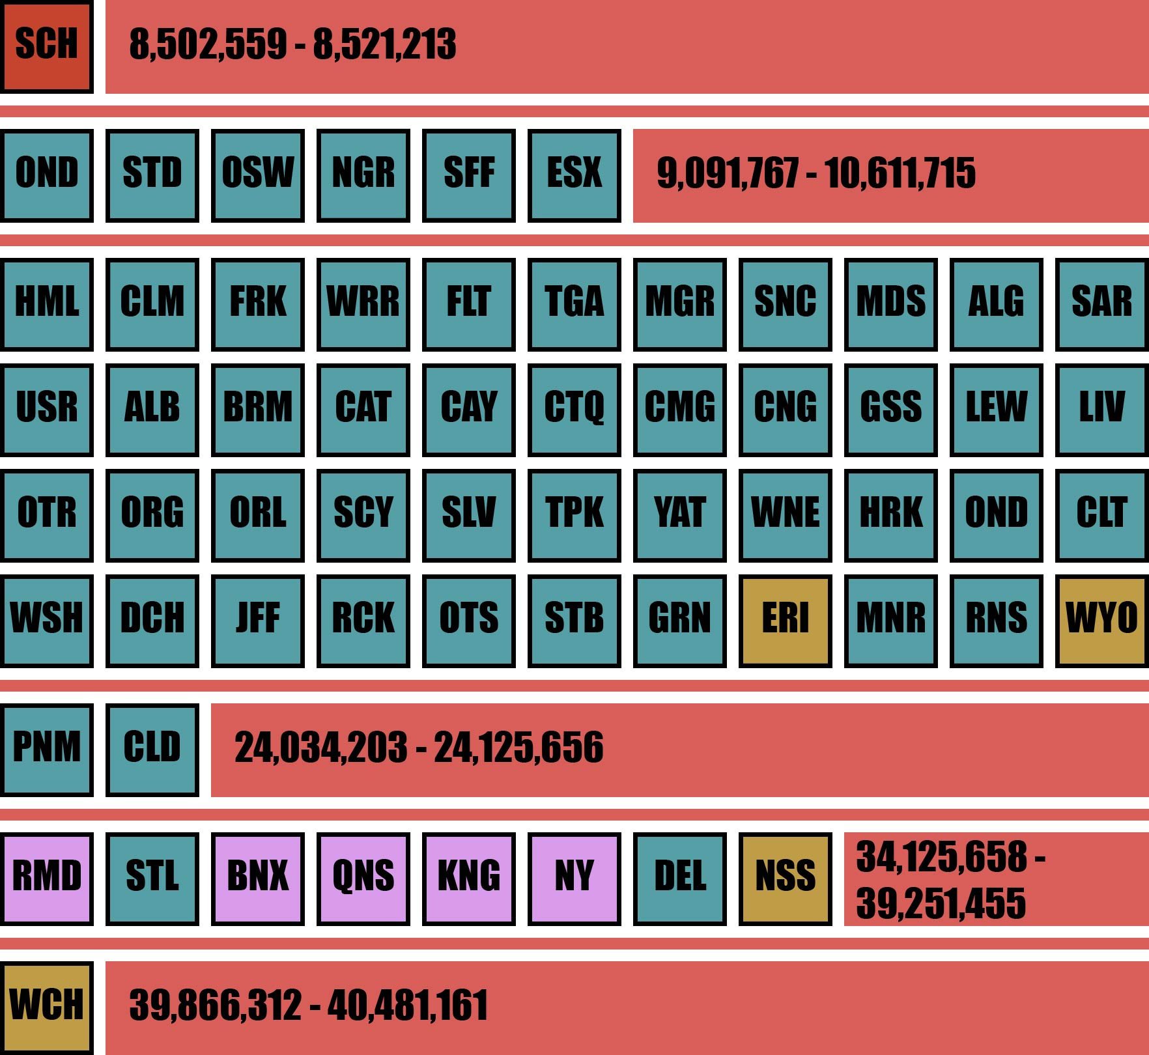
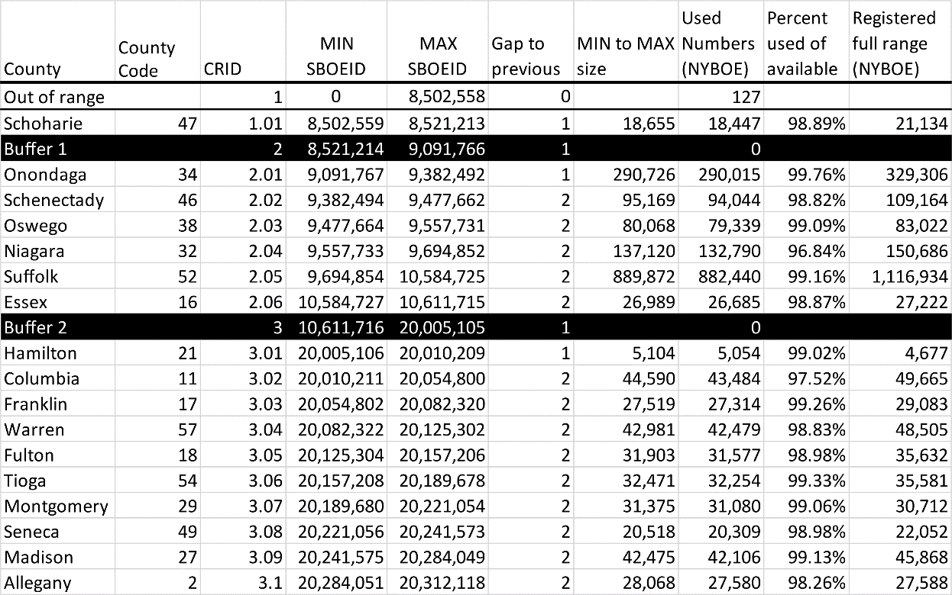
The Spiral sub-partitions

Slide 15
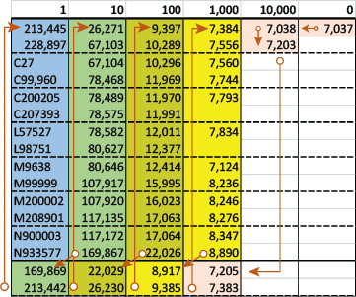
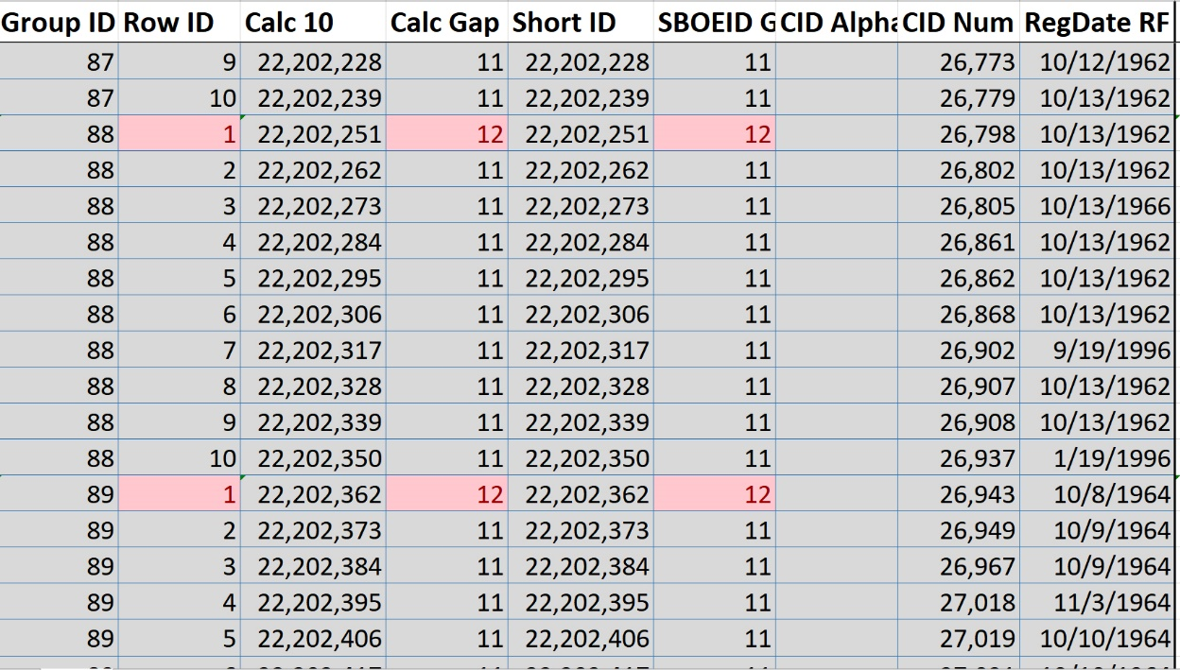
The Spiral (simple view)

Slide 16
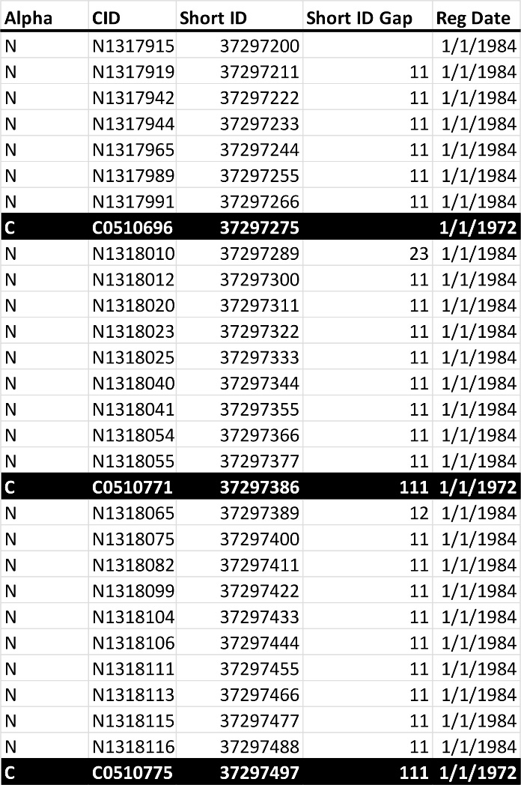
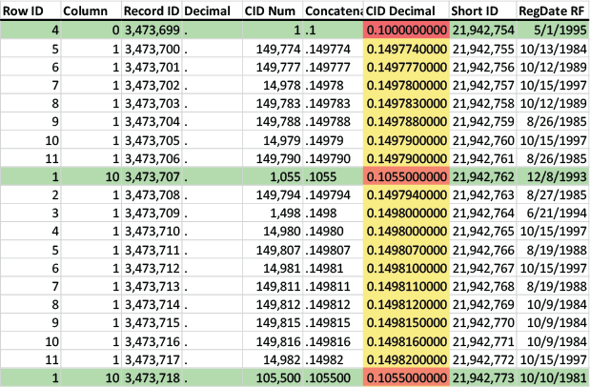
CID transformations

Slide 17
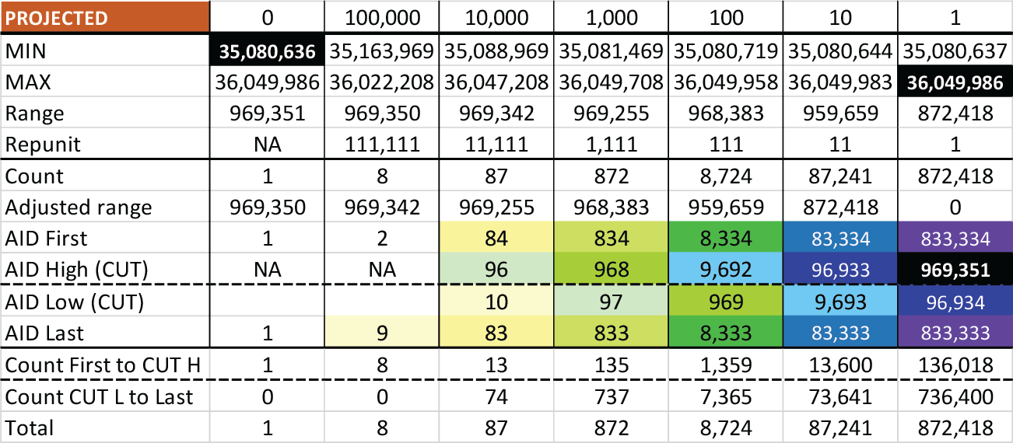
Stacking the deck (controlling ID position)
The Spiral uses columns as a position control mechanism
It divides ranges by “repunits”, numbers like 11, 111, 1,111, 11,111, 111,111, and 1,111,111
Then assigns them to columns based on powers of 10
Then interlaces the numbers based on column assignment
Just like shuffling cards

Slide 18
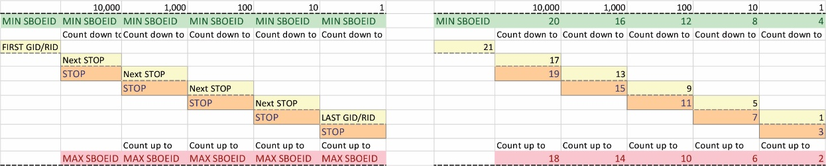
The shift cipher (disguising ID position)

Slide 19
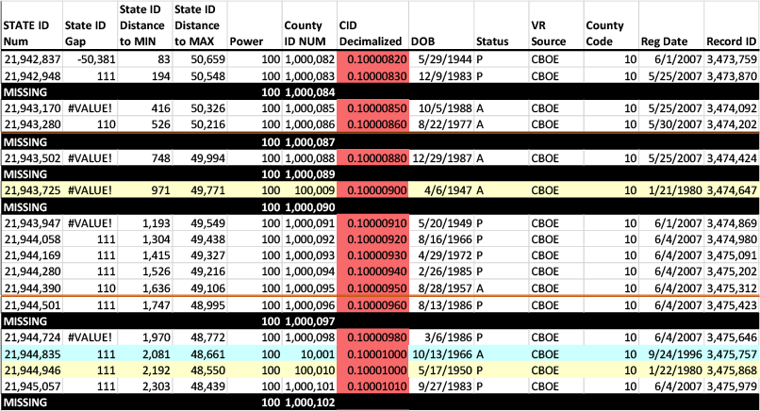
Missing ID numbers found with Spiral

Slide 20
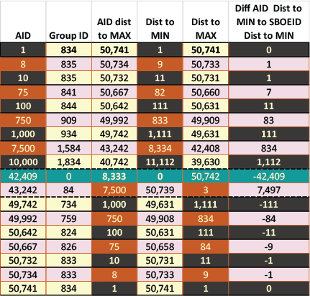
The Algorithm imposed ID number (AID)
Can be used to clandestinely track records
Is hard coded into Spiral
May require an unauthorized copy of the database for use
The Spiral is proven, the AID is strongly suggested, its purpose is unknown, but it has obvious utility for data tracking

Slide 21
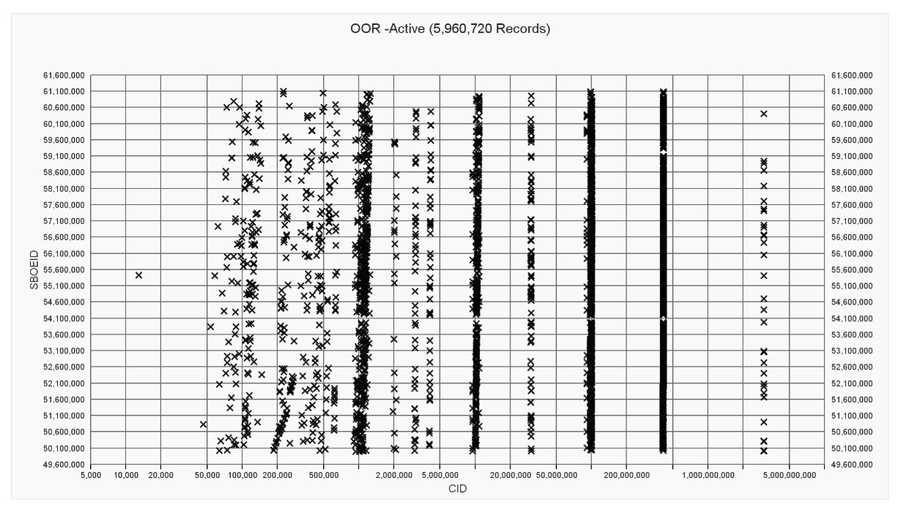
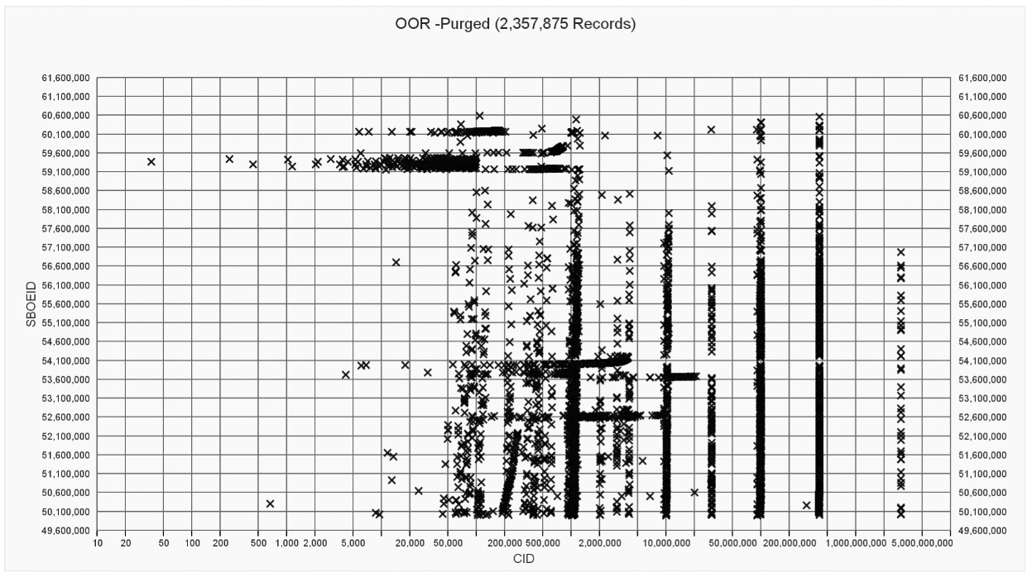
Shingle algorithm: Active vs Purged

Slide 22
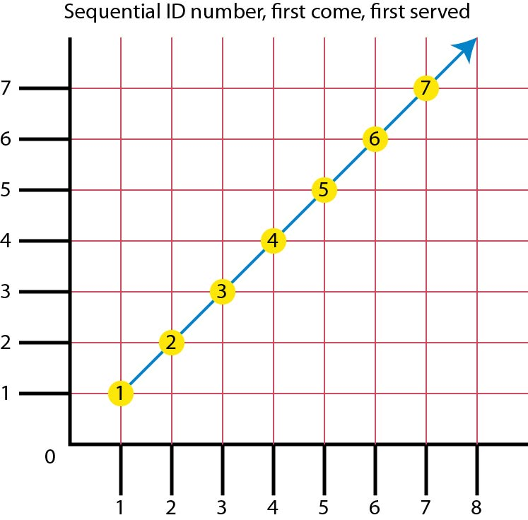
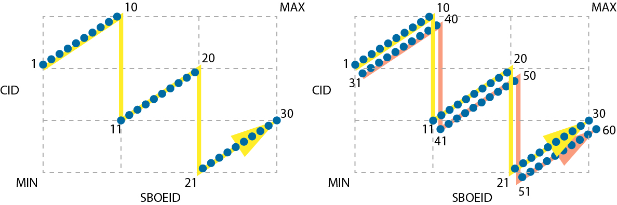
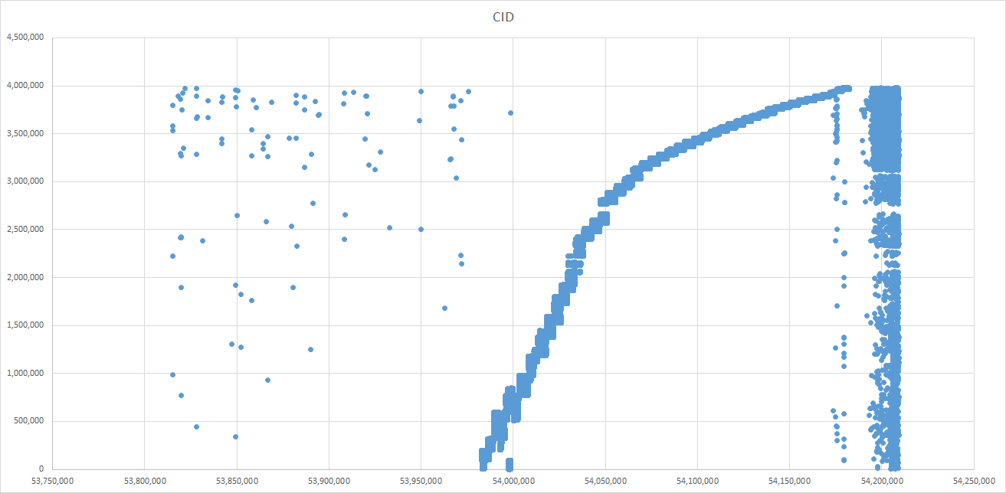
Shingle structure

Slide 23
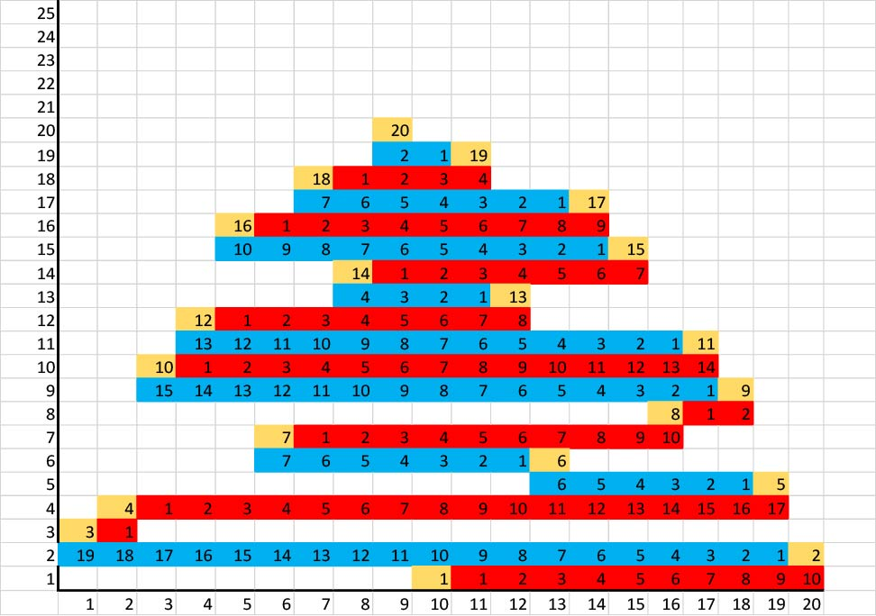
Metronome: Counties 15, 30, 60

Slide 24
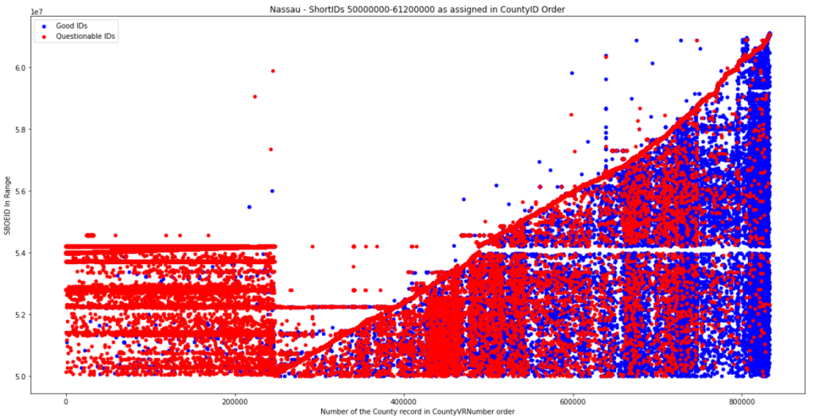
Tartan
Associated with majority of clones (~1,204,158)
All generated after 6/15/2007

Slide 25
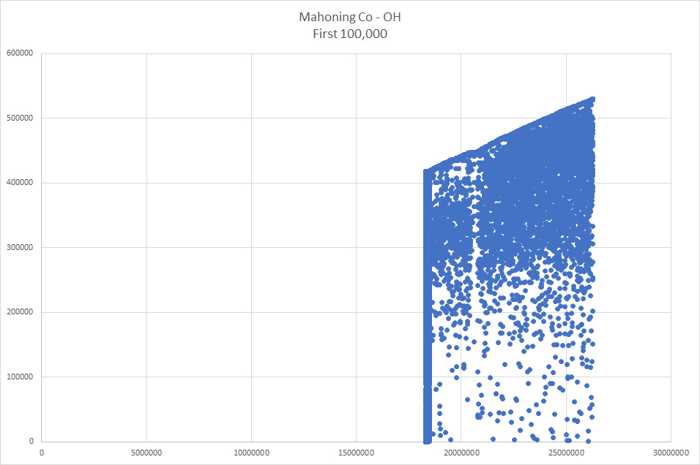
Other states
Hawaii
  Tags records with a 12 digit alphanumeric sequence at the end of a 32 digit UUID
New Jersey
  Scrambles positions of ID number elements
Ohio and North Carolina
  Scatterplots indicate use of algorithms to assign ID numbers

Slide 26

Why were these algorithms used?
No privacy concerns
  All records are public
  No information is masked by algorithms or withheld from public
No security impact
  All records are public
  No need to use covert methods for access
No efficiency improvement
  Retards speed and ease of use

Slide 27

Questions

